Slide 1
Toward SDN for Tactical Edge Networks Y. Richard Yang Yale University

Slide 2

What is SDN?
Separation of data and control paths
Logically centralized control plan
…
Notes:
Risk: having a narrowly defined hammer and looking for nails

Slide 3


A More General View of SDN: Programmable Networks
Same deployed (physical) asset
Programmability to
provide more functions
utilize asset more efficiently

Slide 4
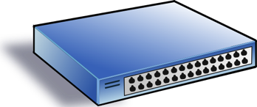
SDN Progress as Programmability Progress
Low-level Programming => High-level Programming
OpenFlow => P4/POF
Service/ Policy
Program Logic
Datapath Model/ Program
Datapath Model/ Program
Network State
Distributed Comp => Logically Centralized Comp

Slide 5
High-level SDN Programming Abstraction: Function Store
public void QoSRouting(Ipv4Address src, Ipv4Address dst, int requiredBw) {
srcNode, dstNode = mapToNode(src, dst);
topology = readTopology();
pq.add(srcNode);
while (!pq.isEmpty()) {
n = pq.pop();
if (bw_src(n) < requiredBw)
return failure
if (n == dstNode)
return writeRoute(src, dst, path);
for (e(n->m): n.neighbors) {
if (min(e.bw, bw_src(n)) > bw_src(m)) {
updateBw(m, min(e.bw, bw_src(n)));
...
}
}
}
return failure }
function instance
function instance
function instance
Allow generic functions
Automatically track data dependency
Automatic clean up, reschedule, and re-execute after dependent data changes (achieve intent)

Slide 6
High-level SDN Programming Abstraction: Magellan
Consider each pkt as a request
- Network as a single virtual server
- Network functions expressed in general purpose language
- Network functions (logically) invoked on each new pkt, returning how net handles that request
- Realization of return is opaque, computed by system

Slide 7
Example Magellan Program
Per-packet programming model
Standard+Custom protocols
void f(Packet p) {
if ( !permit(p) ) p.route = null;
else {
EndpointProp sedp = hostTable(p.ip.ipSrc());
EndpointProp dedp = hostTable(p.ip.ipDst());
int rate = p.te.vRate(); // custom protocol
QoSRoute qr = routingAlg(sedp, dedp, rate);
p.route = qr.route; p.vrate = qr.rate;
}
}
QoSRoute routingAlg(EndpointProp s, EndpointProp d, int r) {
if ( allowedRate(s, d) < r ) // authorization
r = allowedRate(s, d);
return QoSRouting(s, d, r);
}
Meta header to control cross layers
Unspecified realization: Source-routing, compile, or on-demand at switches
Notes:
relatively low rate, unreliable, nodes are highly mobile

Slide 8
Position Statement (I)
There has been substantial progress in the development of a systematic framework of SDN programming abstractions, e.g.,
protocol oblivious programming
high-level SDN programming allowing flexible, high-level, proactive/on-demand programming
Tactical Edge Networks should consider leveraging the progress, to add flexibility, improve efficiency, and simplify control programming.
Notes:
Protocol oblivious datapath and high-level SDN programming can lead to substantial flexibility and efficiency in network control and coordination

Slide 9
Key Barrier
Control Plane
Control-Resource (CR) Channel: Capacity vs Demand
Tactical EdgeNet Resources (Network and Endhost Devices)
Notes:
relatively low rate, unreliable, nodes are highly mobile

Slide 10

Potential Way Forward: CR Channel-Adaptive Control and Programming
Increase capacity
Control Plane
Decrease demand
- Controlled mobility/asset to increase CR channel capacity
Approximate/coarse-grained CC (aka global + local CC)
- Control channel embedding in data Channel (aka fate sharing)
CRC adaptive realization (SR, C, OD)
Opportunistic CC benefits injection
- …
Tactical EdgeNet Resources (Network and Endhost Devices)
- …
Notes:
relatively low rate, unreliable, nodes are highly mobile

Slide 11
Position Statement (II)
The Control-Resource channel can indeed be a key choking point, but many paths can exist
Key next step is to develop better understanding of the limit (aka SDN CR Capacity Theorem), evaluate the limit for key deployment settings
Benefit
demand/capacity

Slide 12
Backup Slides

Slide 13
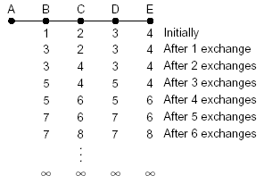
Why Logically Centralized Control?
Inconsistent state
Arrow’s Impossibility Theorem
Notes:
Inconsistent state is a key source of complexity

Slide 14
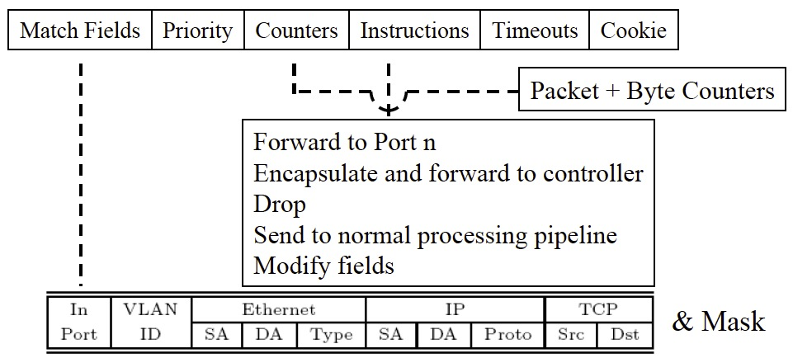
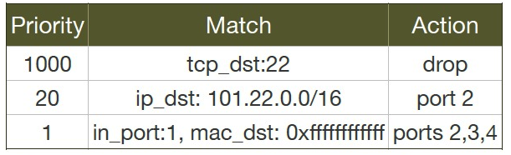
Data Path Abstraction (OpenFlow)

Slide 15
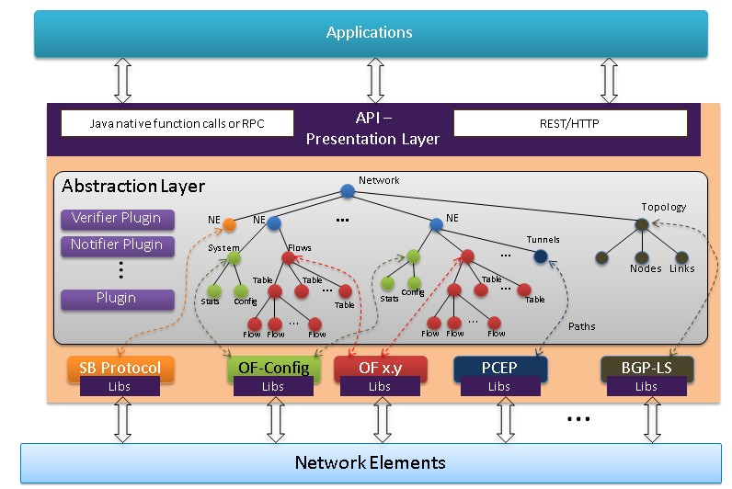
Data Store Abstraction (YANG)
https://wiki.opendaylight.org/view/OpenDaylight_Controller:Architectural_Framework

Slide 16
Magellan Program to Command and Control
“Oracle” Program
DB
Compile
IR
Analyze&Optimize
Datapath Design
Code Gen
Offline
Rules
Batch Explorer
Net State
Update
onDemand Handler
Online
Network and Endhost Devices
Notes:
relatively low rate, unreliable, nodes are highly mobile

Slide 17
Network Forwarding as Caching Lookup
Central control function consists of a sequence of instructions I₁, I₂, …, I_{n}
Each instruction I is a mapping from input variable states to output variable states
InVar(I)₁ | InVar(I)₂ | InVar(I)₃ | OutVar(I)
1 | 1 | 1 | OutVar(I)=I(1,1,1)
…
…
InVar(I)1
I
OutVar(I)
InVar(I)2
InVar(I)3

